Slide 1
EE207 MOSFET Scaling
Saurabh Lodha
EE, IIT Bombay

Slide 2
Outline
CMOS scaling history, present and future
Traditional dimensional scaling
Strain, high-K dielectrics and metal gates
Novel device architectures and materials beyond 22nm node
Video on IC manufacturing

Slide 3
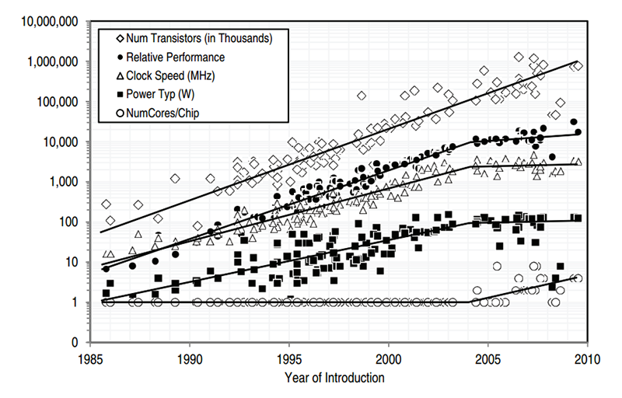
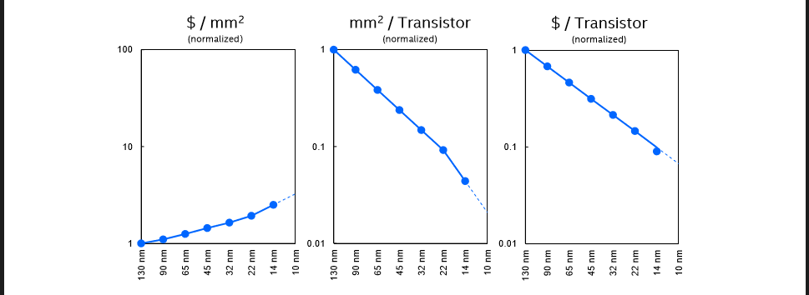
CMOS scaling
Moore’s law: double the number of transistors every 2 years → economic benefit

Slide 4
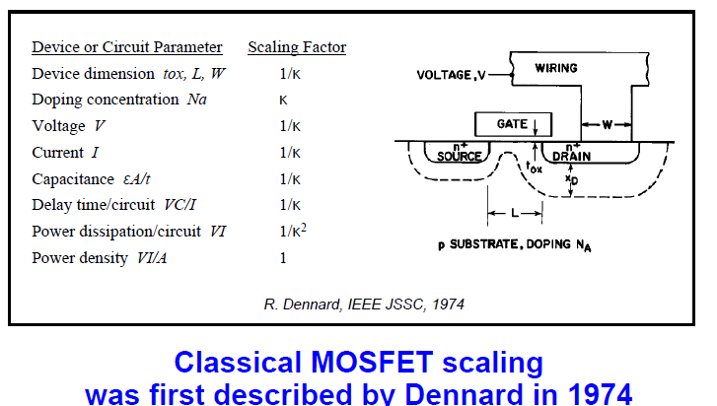
Classical FET Scaling

Slide 5
90nm CMOS Node (2000) End of Conventional Scaling Era: gate oxide thinning reaches fundamental limits
Gate oxide running
out of atoms
Mobility degrades with scaling
Intel Corp.
Gate Oxide Leakage
Direct tunneling limited
Universal Mobility Model
Ionized impurity scattering

Slide 6
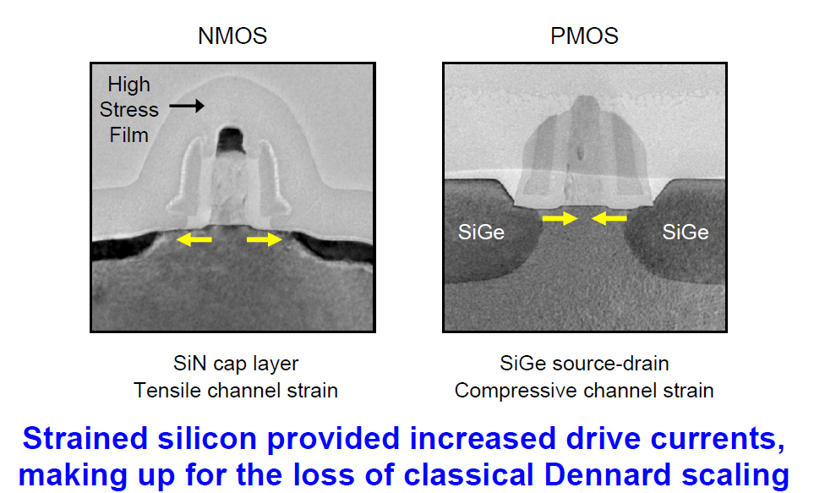
Introduction of strain @ 90nm node
Intel Corp.

Slide 7
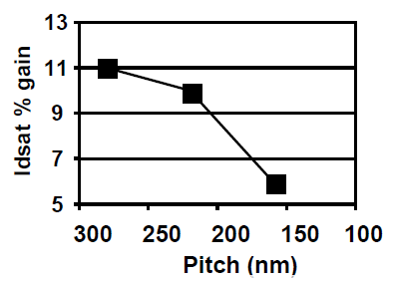
Strain Scaling
Volume effect:
Strain benefits
reduced with
pitch scaling
CD
Con
Pitch
<0.7x
<0.7x
Pitch Scaling
0.7x
Intel Corp.

Slide 8
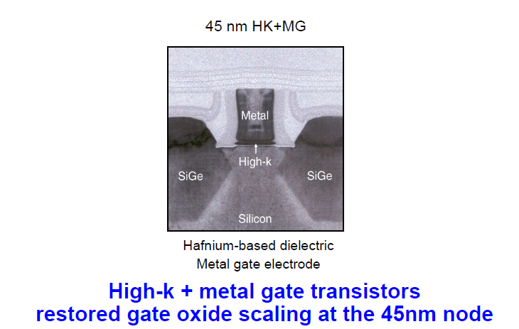
45nm Node: Hi-K/Metal Gate (2007)
Intel Corp.

Slide 9
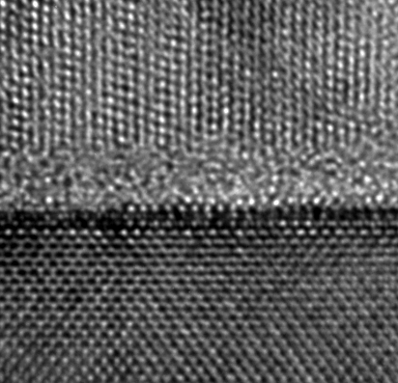
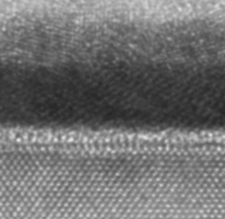
Hi-K Dielectrics: Key Benefit
Gate
Gate
1.2nm SiO₂
3.0nm High-k
Silicon substrate
Silicon substrate
Source: Intel
90nm process
1X
1X
High-k
1.6X
< 0.01X
Capacitance
Leakage

Slide 10
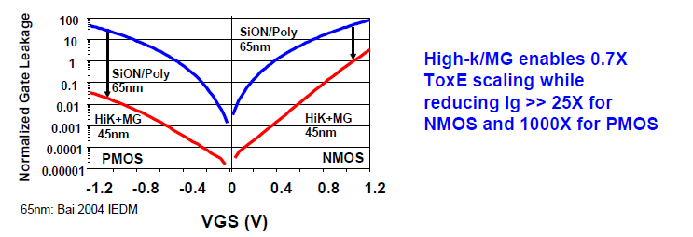
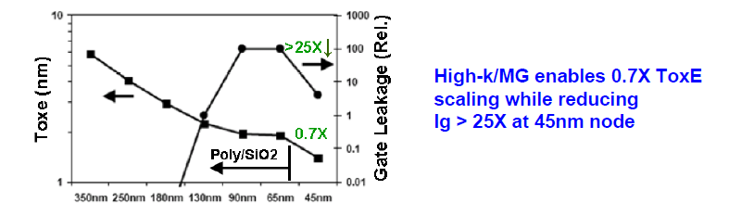
High-k Metal Gate: ToxE and Ig
Intel Corp.

Slide 11
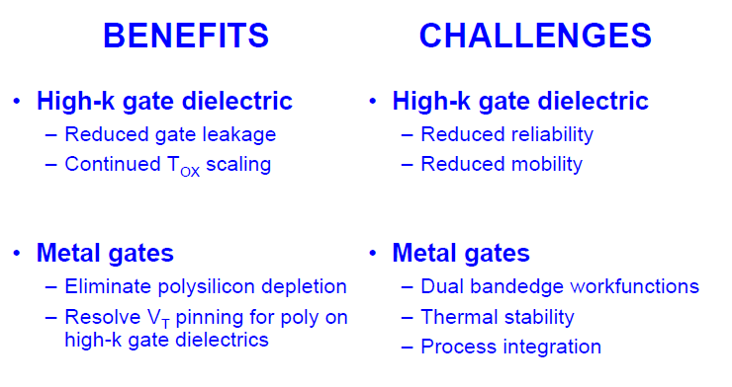
High-k Metal Gate

Slide 12
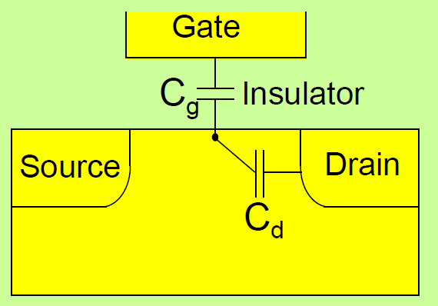
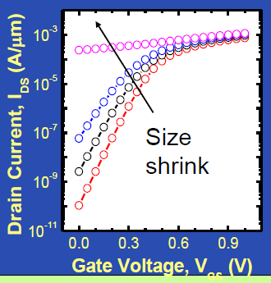
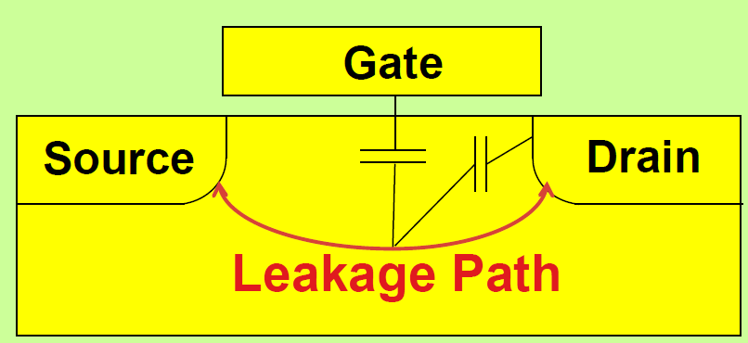
What was the challenge?
Source: Cheming Hu, UC Berkeley
MOSFET becomes a resistor at small L- drain competes with the gate to control the barrier
Gate cannot control the leakage path far from the gate

Slide 13
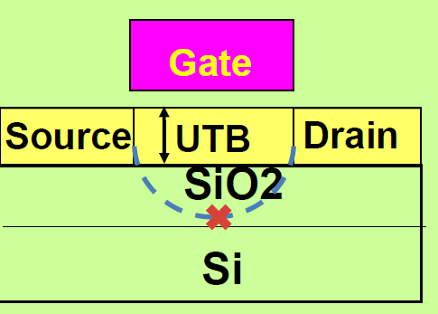
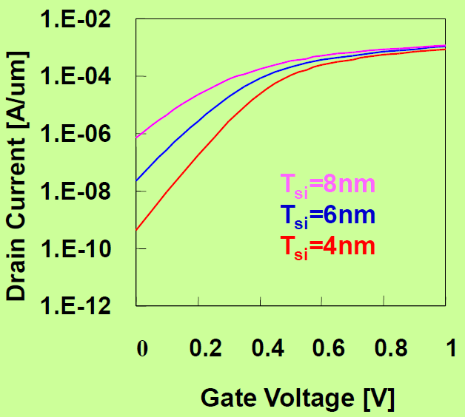
Solution 1: UTB-SOI, Ultra-thin body Silicon-on-insulator
Source: Cheming Hu
No leakage path far from the gate

Slide 14
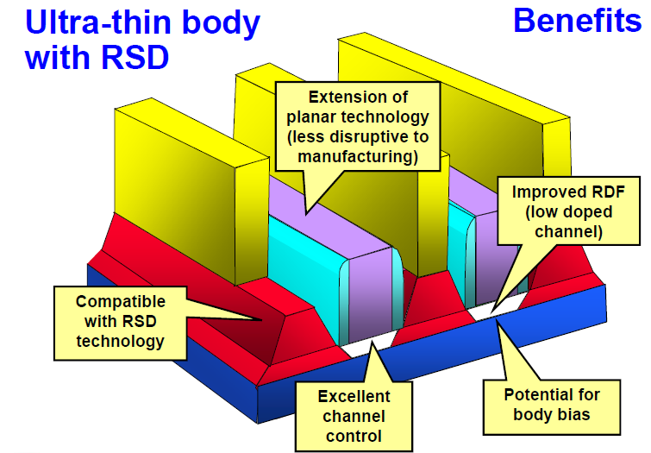
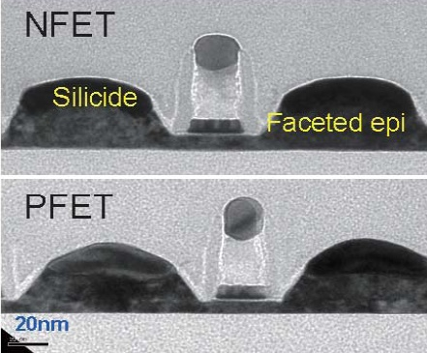
New device architectures
Cheng , IBM – VLSI 2009
Intel Corp.
Challenges:
Manufacturing with thin Tsi
Tsi control for Vt
Rext, strain, transport

Slide 15
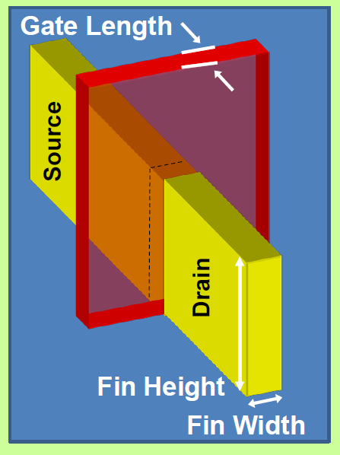
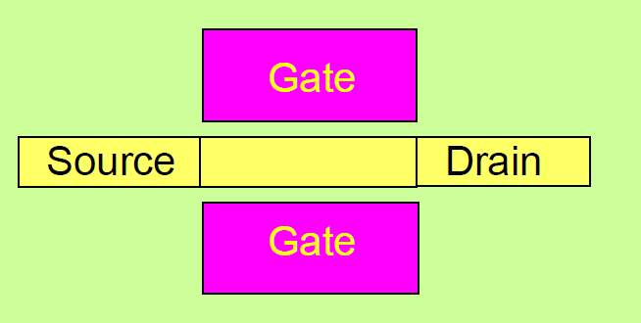
Solution 2: 3D FinFET
Source: Cheming Hu
Fin controls a thin body from more than one side

Slide 16
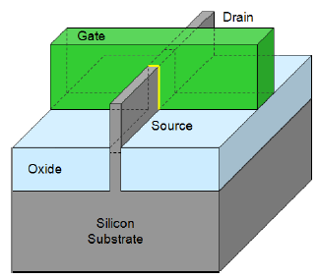
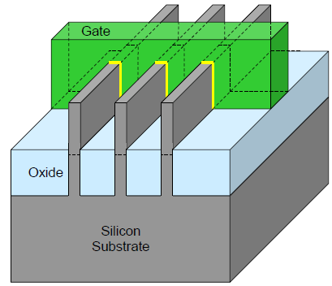
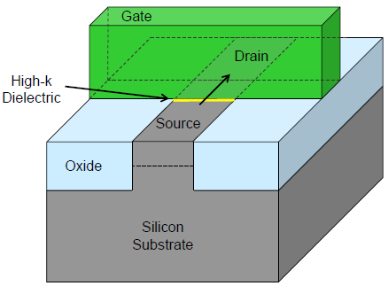
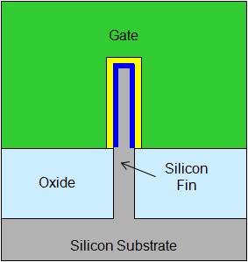

New device architectures
FinFET/Trigate-FET/MuGFET
www.intel.com
Multiple-gate, thin-body
➔ Better electrostatics, More scalable
Notes:
16

Slide 17
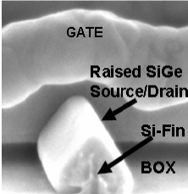
FinFET/Tri-Gate
New device architectures
LG
Kavalieros – Intel –
IEDM 2006
LG
Drain
Gate
Gate
Source
Source
Drain
Hsi
Wsi
Conventional Planar FET
Non-Planar Multi-Gate
Benefits:
Nearly ideal sub-threshold slope/SCE (gates tied together)
Excellent Channel Control
Improved RDF (low doped channel)
Challenges:
Manufacturing due to 3D
R_{ext}, strain due to thin fins
Variability in H_{si}, W_{si} → V_{t}

Slide 18
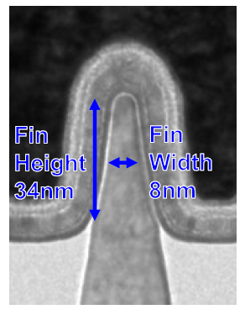
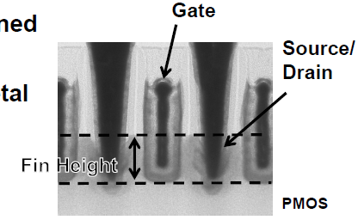
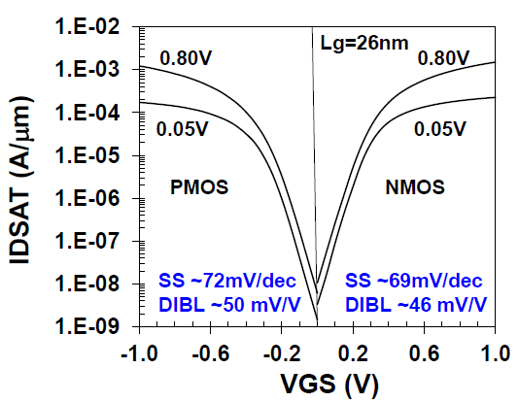
22nm CMOS node: Trigate (2012)
Best reported SS and DIBL in manufacturing
Intel’s 22nm Transistor Technology

Slide 19
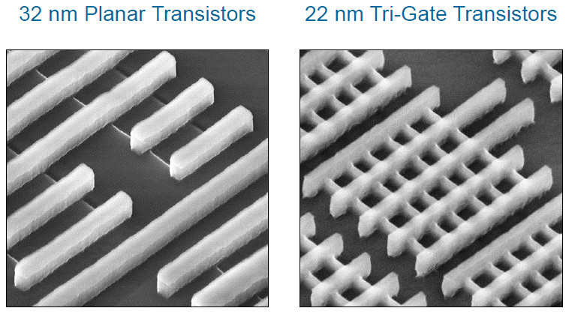
FinFET/Trigate-FET/MuGFET
www.intel.com
Notes:
19

Slide 20
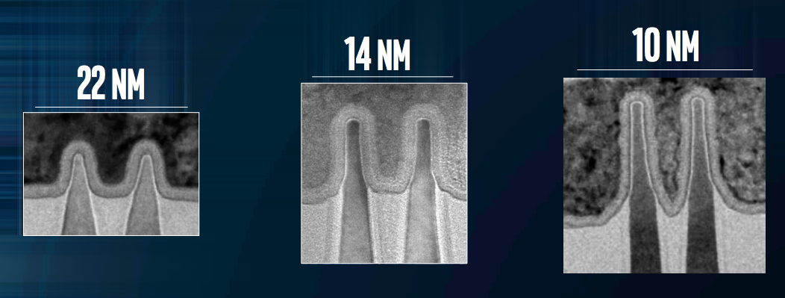
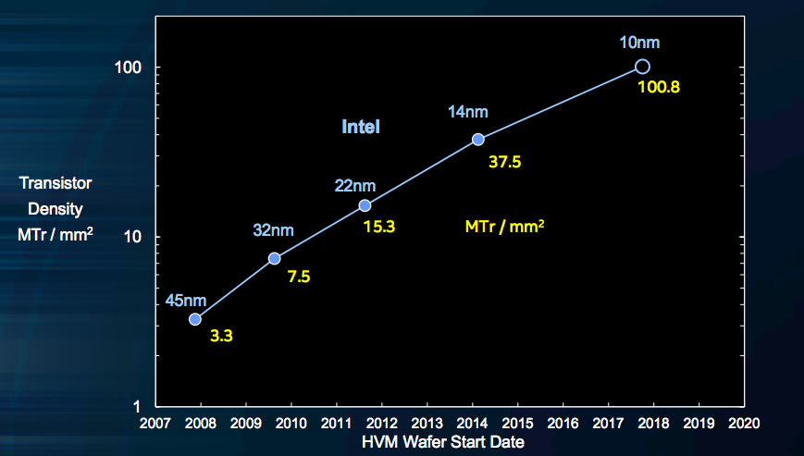
22 nm (2012) – 10 nm (2018)
FinFET scaling (taller and thinner) has worked for the last 6 years

Slide 21
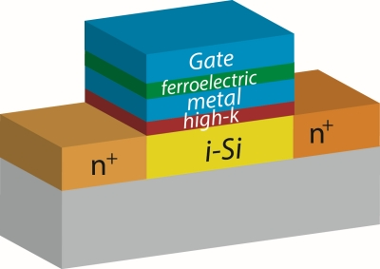
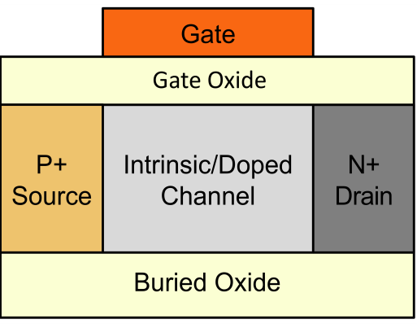
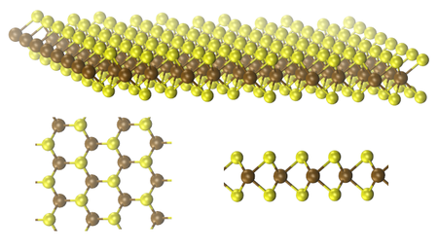
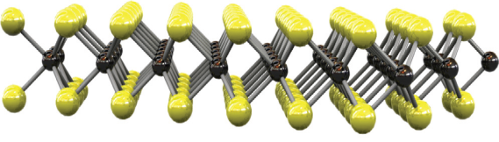
What’s next for Moore’s law?
LG
Improved Electrostatics/Sub-threshold Slope
Drain
Gate
Scaled FinFETs
GAA FETs
Tunnel FETs and NC FETs
Ultra thin (2D) materials: MoS₂, WSe₂
Source
Hsi
NC-FET
Wsi
P-I-N TFET
MoS₂
Source
Drain
SiO₂
0.7 nm
Back Gate

Slide 22
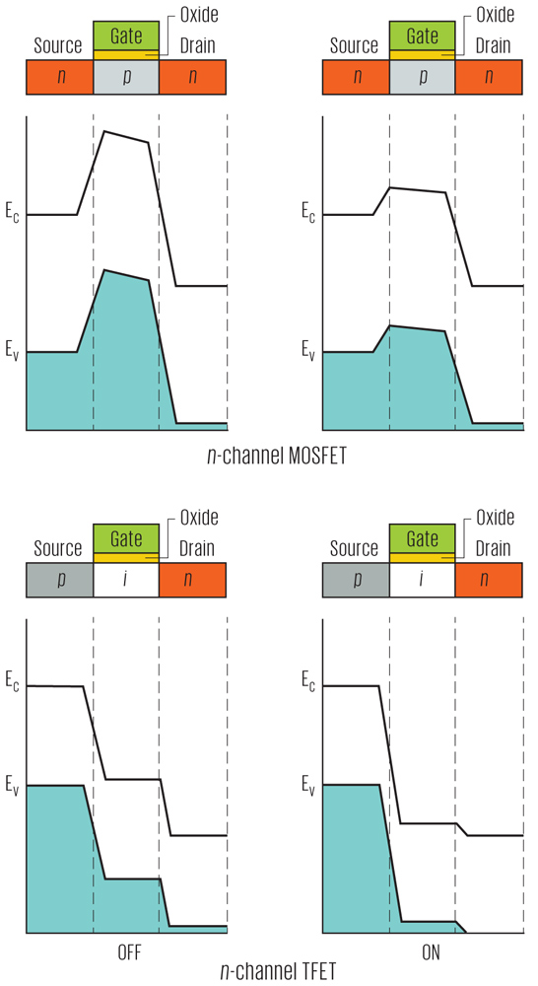
Tunnel FET
Tunneling beats the kT/q thermal limit for transistor switching
http://spectrum.ieee.org/semiconductors/devices/the-tunneling-transistor

Slide 23
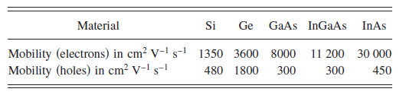
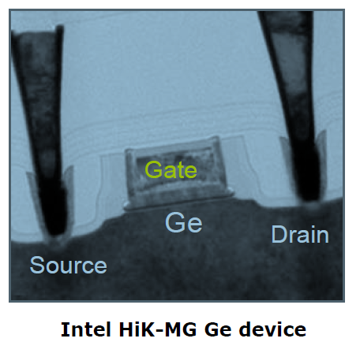
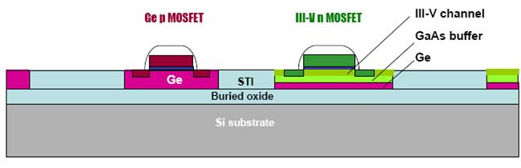
What’s next for Moore’s law?
High Mobility/Injection Velocity
I_{d}=μC_{ox}/L_{eff} (V_{g}-V_{t})^{α}
Mobility enhancement using alternate channel materials, strain, wafer orientation
Lubow et al., APL 96 122105 (2010)
Ge is a single material CMOS solution
Integral part of Si foundries
Intel Developer Forum, Sept. 2011

